Slide 1

Python Tsunami
– April 7th-8th –

Slide 2




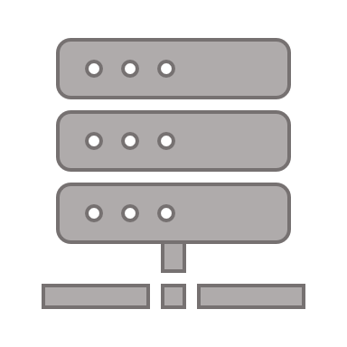
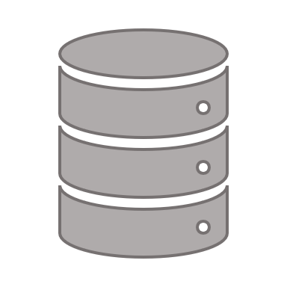




Center for Health Data Science
The Data Science lab:
Provides data science support for all research groups at SUND
Organizes workshops/seminars
Research units:
work on different areas and topics within the field of health data science
https://heads.ku.dk

Slide 3
Center for Health Data Science
Courses:
Excel to R (June 15th & 16th)
Computerome user workshop (May 6th )
Git and Github workshop (date tbd)
https://heads.ku.dk/

Slide 4

This course
originally developed at the Center for Protein Research (CPR) by:
Alberto Santos Delgardo (University of Oxford)
Henry Webel (NNF CPR)
Annelaura Bach Nielsen (NNF CPR)
Rita Colaço (PRI)
We say thank you for the course material (which we have adapted).

Slide 5






The HeaDS version
Jose Alejandro Herrera Romero - Alex (HeaDS)
Marilena Hohmann (HeaDS)
Rita Colaço (PRI)
Inigo Prada Luengo (HeaDS)
Viktoria Schuster (HeaDS)
Henrike Zschach (HeaDS)

Slide 6
About this course

Slide 7
Program
 | Thursday 7th of April | Friday 8th of April
8:45-9:00 | Morning Coffee (optional) | Morning Coffee (optional)
9:00-09:45 | Introduction and motivation | Recap from yesterday
9:45-10:00 | Coffee break
10:00-11:00 | Variables and data types: numbers, math operators, strings | Functions
11:00-12:00 |  | Pandas
12:00-13:00 | Lunch break
13:00-14:00 | Iterables I: lists | Pandas/Visualization
14:00-14:45 | Iterables II: sets, dicts, tuples | Visualization
14:45-15:15 | Coffee break
15:15-16:00 | Logical operators and conditions | Exercise and wrap-up
16:00-17:00 | Loops
17:00-17:30 | General questions | General questions

Slide 8
What will you learn in this course?
The basics of Python
Jupyter notebooks/Colab
Pandas
Visualization
Good practice

Slide 9
Motivation

Slide 10

Why Python?
Obligatory xkcd: https://xkcd.com/353/

Slide 11
Why Python?
Python is easy to use, powerful, and versatile
A great choice for beginners and experts alike
Python’s readability makes it a great first programming language
It has a huge community behind developing useful libraries in many different fields (i.e biology, imaging, etc.)
It can be optimized easily

Slide 12
Basic concepts
What is programming?
Objects and Functions
How do you approach a problem?
Principles of programming
Class, Object, attribute, functions

Slide 13

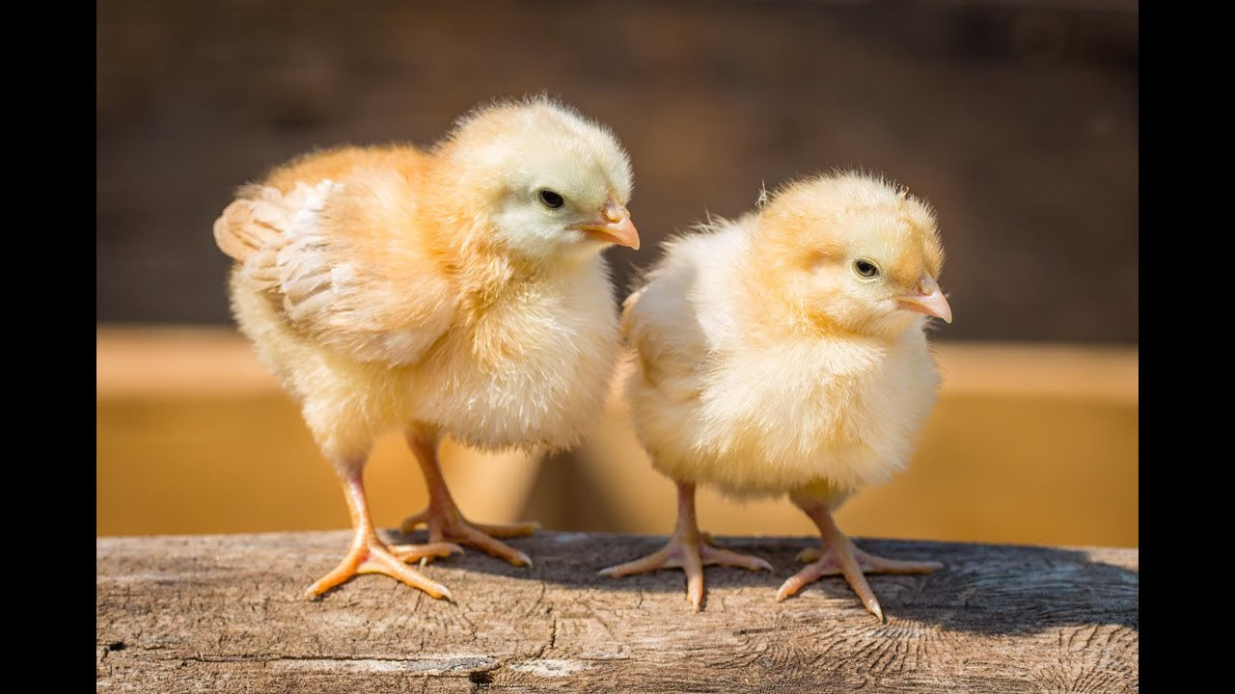
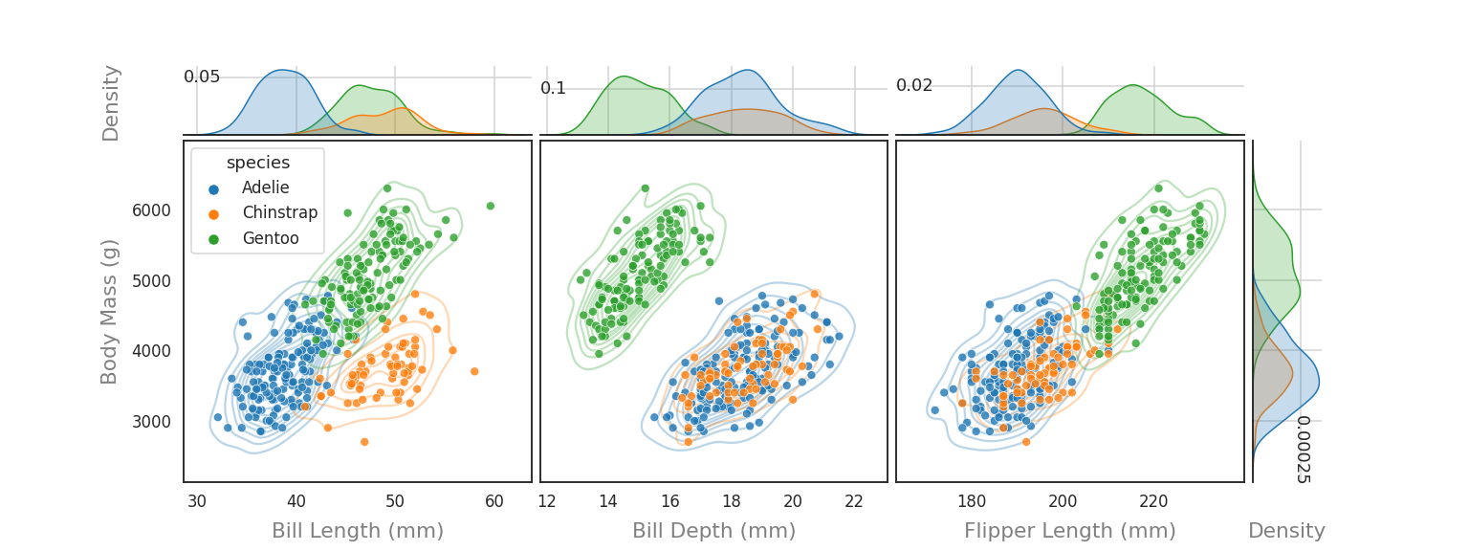
What is programming?
A data processing workflow:
input
Put put
output
We will attempt to shed some light on this part

Slide 14
What is programming?
Programming is instructing a device to performcertain tasks in a language the device understands
For example you can program your washing machine to wash while you are at work.
Or you can program a machine that understands python to read in data and make a plot
Programming is not difficult, though mastering it can be challenging

Slide 15
Why is programming
nice?
It may not appear so, but unlike lab equipment it is quite difficult to break a computer
You can find plenty of useful online resources (i.e. stackoverflow, tutorials, ect)
Automate tasks
Important tool in a world that is becoming more and more data heavy

Slide 16
The language of programming

Slide 17

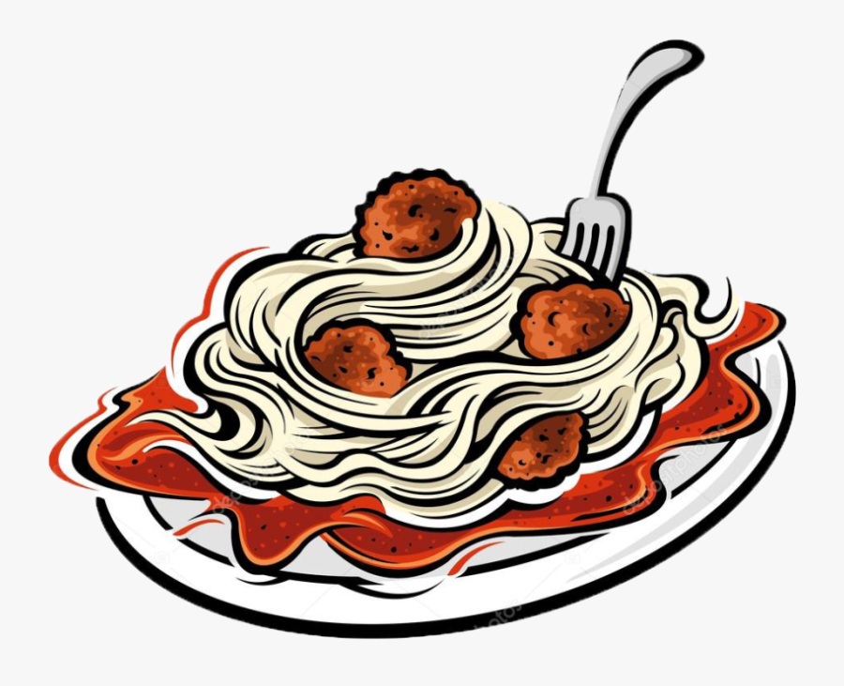
Very roughly
python programs are made up of:
We performs functions on objects.
Objects
Functions
drive
eat
In a programming context, these objects are pieces of information, i.e :
- a string (sequence of letters, i.e. a DNA molecule)
- a number (i.e. someone’s resting pulse)
- a date
- a data table

Slide 18
Very roughly
python programs are made up of:
Which functions can be performed depends on the type of object:
Different objects can have the same (or a comparable) function performed on them.
I.e. most objects will have a print function defined on them that displays their content.
brag
Objects
Functions
Some functions are only defined on certain object types:
drive
Functions can also be defined between objects:
3 + 5 = 8
Two objects of type integer can be added to each other.

Slide 19

Very roughly
python programs are made up of:
If two objects are of the same type we can perform the same set of functions on them.
drive, refuel, honk, bring to the repair shop, ...
Objects
Functions
They can still have different attributes/ characteristics though. Actually, these are two different instances of a car object if we want to be technical.
Like a blue and a red car, you can have two string objects that have different contents, i.e. :
string_a = ‘Yes, this is dog.’
string_b = ‘Python is great!’

Slide 20
Very roughly
python programs are made up of:
We mostly create objects in one of two ways:
1. Declaring a variable
2. Loading in data
Objects
Functions
To define variables, we simply decide on a name of variable and use ‘=‘ to assign values:
my_first_variable = 3
Variables can have different types:
my_first_variable = 1 # integer
my_second_variable = “This is my second variable” # string
my_third_variable = 3.3 # float
This goes back to that the functions you can apply depend on the type of the object. All variables in python point to objects (we will not think too deeply about this for now).

Slide 21
Very roughly
python programs are made up of:
Functions are applied to objects like so:
Build-in functions:
my_string = “Yes, this is dog”
print(my_string)
Depending on the function you can pass additional parameters:
print(my_string, end = ‘!\n’)
You can also define your own functions and call them by using their name:
def sum_two_numbers(a, b):
return a + b
def say_hi():
print(“Hi”)
sum_two_numbers(3,5)
We typically define functions to alias a piece a code that we want to re-use. More on that later.
Objects
Functions

Slide 22
Strategy for Programming
Programming often starts with a pen and a piece of paper:
What is your input?
What is your desired output?
What are the steps required to turn your input into your output?
The roadmap
input
Put put
output

Slide 23
Strategy for Programming
Programming often starts with a pen and a piece of paper:
What is your input?
What is your desired output?
What are the steps required to turn your input into your output?
Divide and conquer
Problem
subproblem
subproblem
subproblem

Slide 24
Example:
I have a table with heart measurements from subjects. I want to plot them, calculate the mean and find out if there is a statistically significant difference between patients and healthy people.
Input: ?
Output: ?
Steps: ?
Strategy for Programming
Divide and conquer

Slide 25
Example:
I have a table with heart measurements from subjects. I want to plot them, calculate the mean and find out if there is a statistically significant difference between patients and healthy people.
Input: a csv file
Output:
a) boxplot
b) means
c) p-value
Steps:
Load in data
Calculate means
Make plot
Perform t-test
Strategy for Programming
Divide and conquer

Slide 26
Strategy for Programming
Why I recommend ‘programming’ on paper before getting started:
It is cumbersome to hold all your ideas and concerns in your head until you come to the part in the program where you need them
It is easy to get lost in technicalities and lose your overview
It is easy to write confusing code that works once and then spend double the time when you need to re-run or check your analysis
The roadmap

Slide 27
Strategy for Programming
Use pre-existing libraries and functions
Unless you’re very hard core or your analysis is extremely specialized you will probably do something that someone, somewhere has done before.
It is generally a good idea to use pre-existing libraries and functions/analyses where possible because they are:
Tested
Optimized
Re-usable
Documented and easy to document (think workflow)
Work smarter,
not harder

Slide 28
Strategy for Programming
Keep it DRY:
Don’t Repeat Yourself
simply put: do not repeat the same piece of code over and over
because errors can happen, can forget to change one of the repeating sections
Instead use loops to repeat actions
for complex actions you can write a function and call that function several times
Work smarter,
not harder

Slide 29
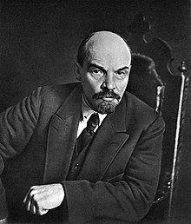
Trust is good, checking is better
- allegedly V. I. Lenin, now popular saying in countries that use the Deutsche Industrie Norm
Strategy for Programming
Things to think about:
Is your input what you think it is? Are there missing or unexpected values, i.e. does anyone have a heart rate of ‘Yes’?
Is your output correct? This can be difficult to verify, after all that’s why you made the program. You can i.e. use a test set where you know or have checked by hand what the result should be
Overall: Does your program do what you think it does?
What about edge cases?
What kind of situation could cause your program to malfunction and how can you check for that?
Test, test, test

Slide 30
Tools and Environments

Slide 31
How do I work with Python?
Setting up Python
Virtual Environments
Jupyter Notebooks
Google Colab

Slide 32

Local installation
Pros:
Your own local installation
Easy access to data stored locally
More control over installed versions
Not difficult if done right
Cons:
May require solving issues (sometimes obscure) if incorrectly installed
Each Operating System (Windows, MacOS, Linux, …) may require specific steps

Slide 33

Conda
Local installation
open source package and environment management system
Originally created for python but can package and distribute software for any language
Pandas 1.0
App 1
Python 3.7
App 2
Pandas 1.25
App 3
Python 3.8

Slide 34
Virtual Environments
Conda
open source package and environment management system
Originally created for python but can package and distribute software for any language
App 1
environment 1
Python 3.7
Pandas 1.0
App 2
Environment 2
Python 3.7
Pandas 0.25
App 3
Environment 3
Python 3.8
Pandas 0.25
an environment is a virtual place that has specific versions of python and packages installed
You can create, activate, deactivate, switch and export environments

Slide 35
How do I work with Python?
Setting up Python
Virtual Environments
Jupyter Notebooks
Google Colab

Slide 36
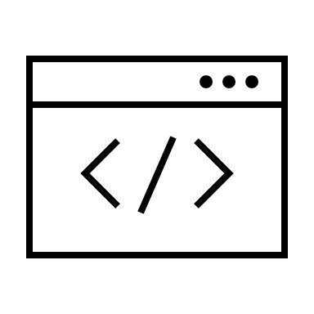



Writing and editing code
Terminal 2 options:
Shell: python
Interactive shell: ipython
Simple text editors:
Notepad++
Vim
Integrated development environments (IDEs) Several options:
IDLE
PyCharm
Spyder
Visual Studio Code
Jupyter Notebooks
Google Colab

Slide 37

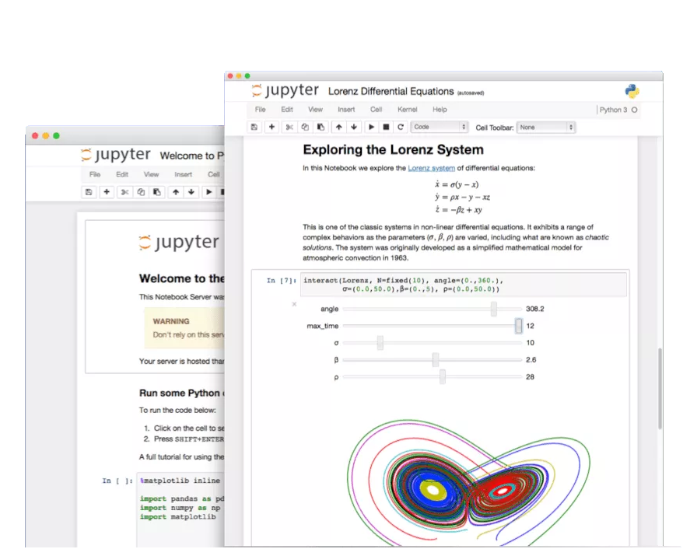

Jupyter Notebooks
Jupyter Notebook
The Jupyter Notebook is an open-source application to create and share documents that contain code, equations, visualizations and text (markdown)
Browser-based development environment for creating, running and sharing python code
Combine code with text and output
typically installed with conda
i.e. it’s not jupyter VS conda, you use conda to manage jupyter and your other packages

Slide 38


Google Colab
Colab (Colaboratory) is a tool to write, execute and share python code through the browser
Colab is especially well suited to machine learning, data analysis and education.
Colab is a hosted Jupyter notebook service that requires no setup to use, while providing free access to computing resources including GPUs
It is connected to a Google account and data can be accessed through Google Drive.
https://colab.research.google.com/

Slide 39





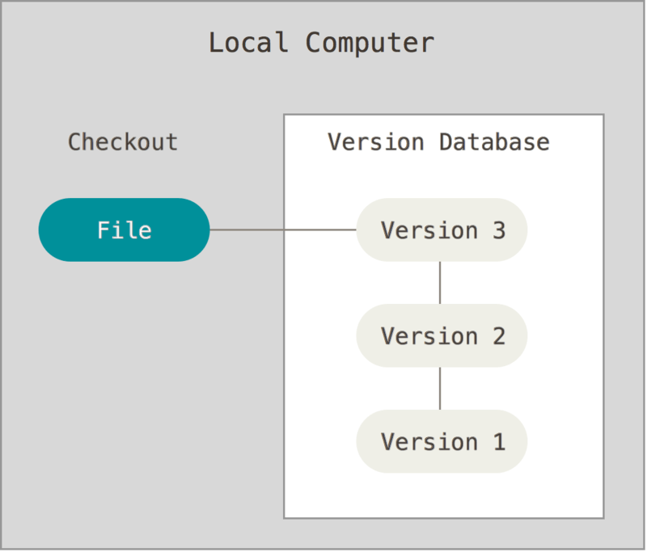


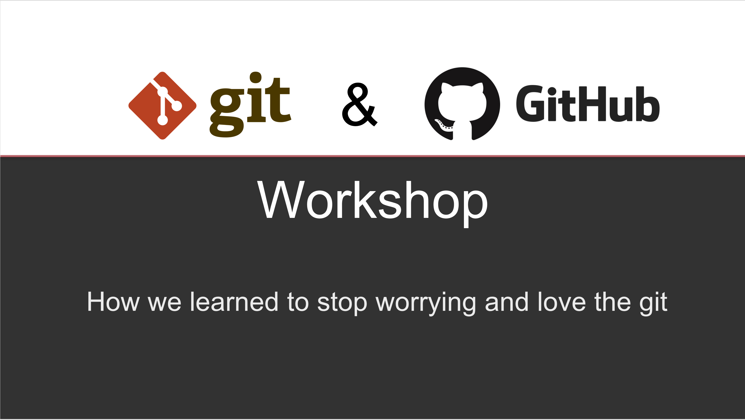
Taking Control of Your Code
manuscript_draft.doc
manuscript_draft2.doc
manuscript_draft3.doc
manuscript_final1.doc
manuscript_final33_mod_JADH_GGS_final44_reviewed_FH_2.2.1.doc
Version control
It is a system that records changes to a file or set of files over time so that you can recall specific versions (history)
Important in coding, especially when the code is accessed by “many” people (>1)
A good way to share your code with others
Git is a software for tracking changes and coordinating work among collaborators developing code
GitHub facilitates access to Git’s functionality
Recommended
https://github.com/Center-for-Health-Data-Science/PythonTsunami

Slide 40
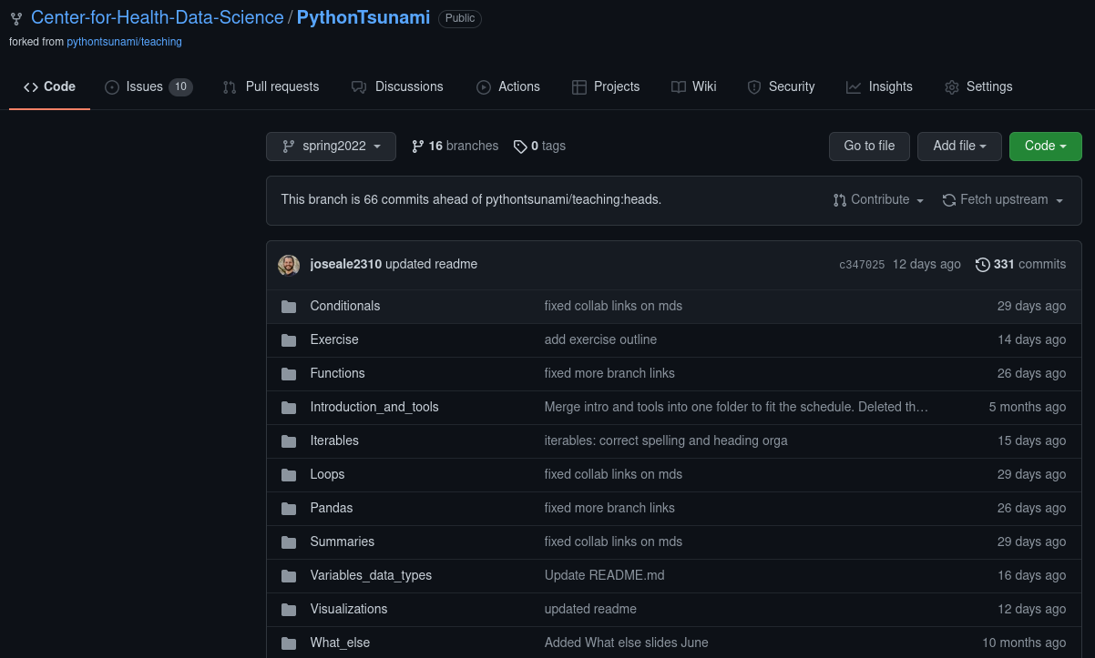
Find course material here:
Material for this course
https://github.com/Center-for-Health-Data-Science/PythonTsunami

Slide 41
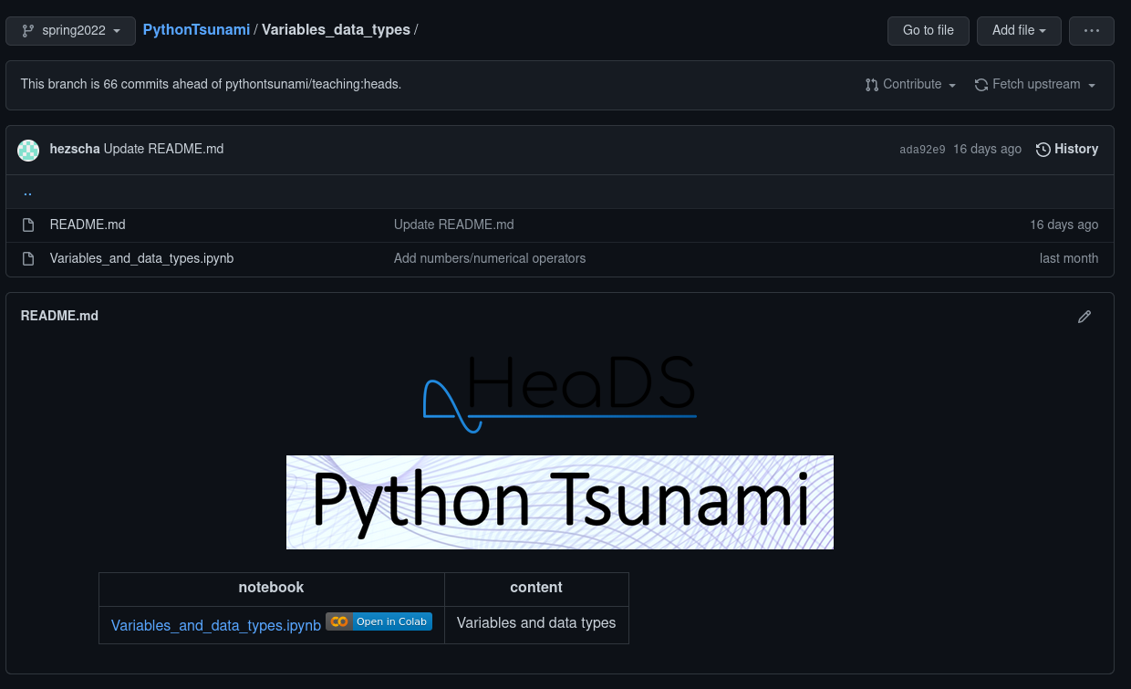
Find course material here:
Material for this course
https://github.com/Center-for-Health-Data-Science/PythonTsunami

Slide 42
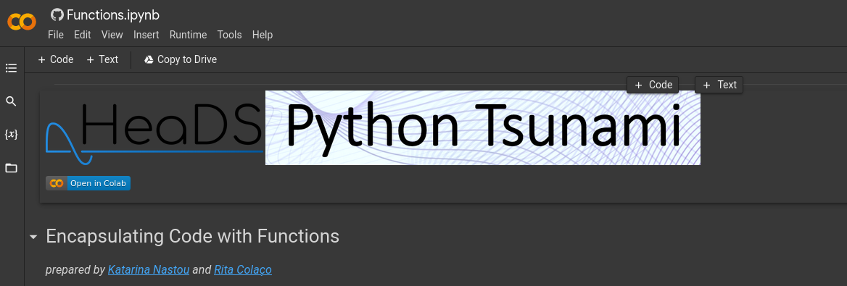
Find course material here:
Material for this course
https://github.com/Center-for-Health-Data-Science/PythonTsunami
Important: Copy material to your google drive so you can make notes and do the exercises

Slide 43
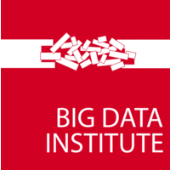

Thanks!

